Slide 1
Sequential Logic
Counters

Slide 2
Counters
A special type of sequential circuit used to count the pulse is known as a counter. It's a collection of flip flops where the clock signal is applied is known as counters.
The counter that counts in ascending order is Up Counter
The counter that counts in descending order Down Counter.
Counters are divided into two categories:
Asynchronous(Ripple) counter - No Universal clock for flip-flops
Synchronous counter – Universal clock for flip-flops

Slide 3
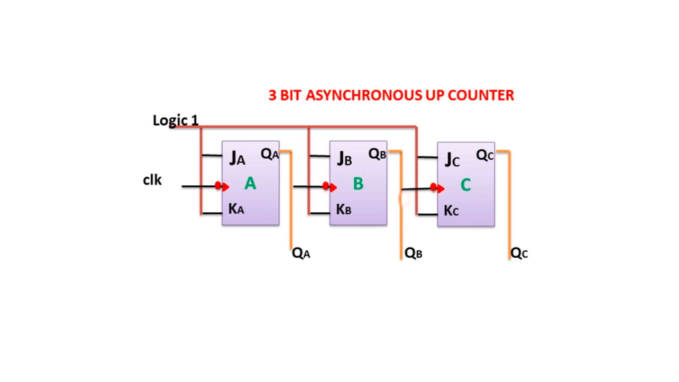
3-bit Asynchronous Up Counter

Slide 4
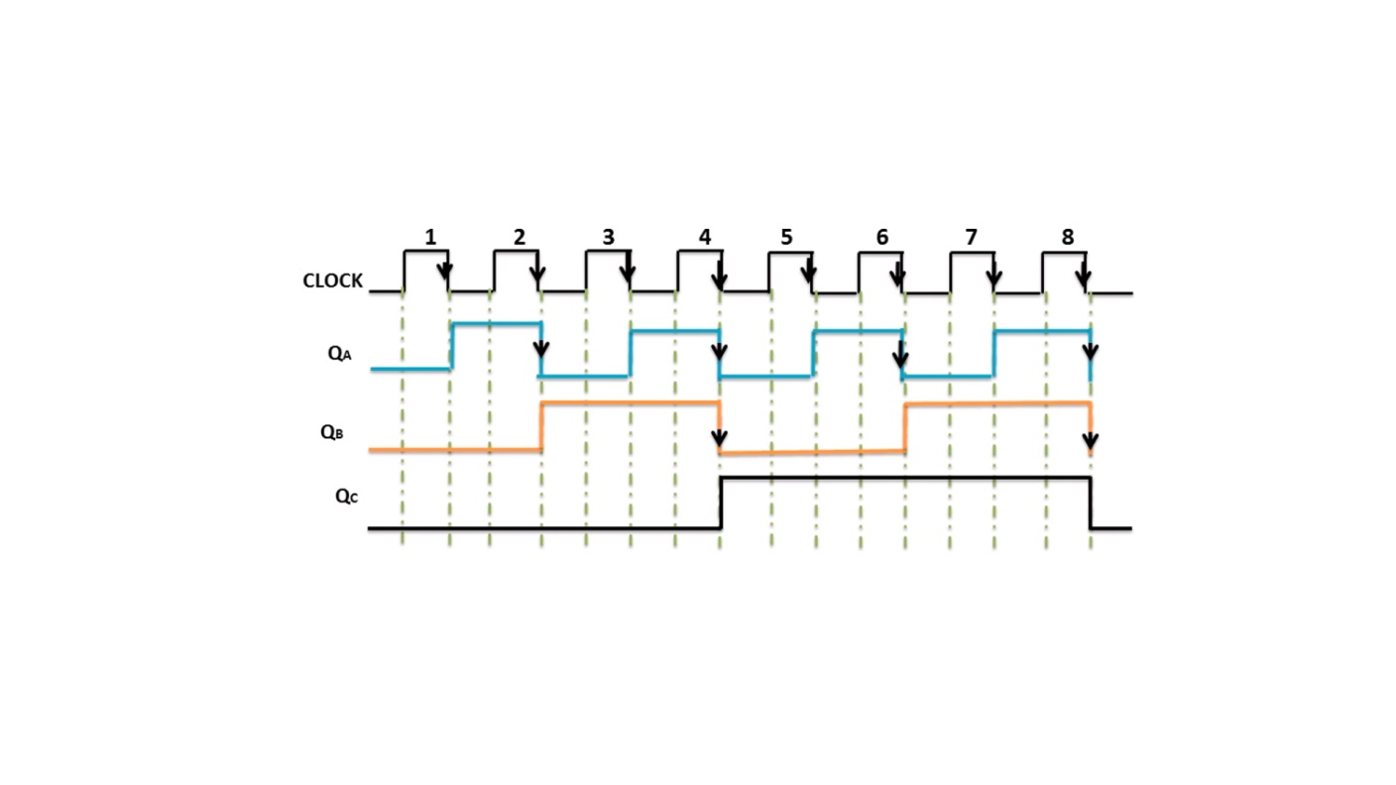
3-bit Asynchronous Up Counter

Slide 5
3-bit Asynchronous Up Counter
Clk | Qc | Qb | Qa | Dec
Initially(0) | 0 | 0 | 0 | 0
1st | 0 | 0 | 1 | 1
2nd | 0 | 1 | 0 | 2
3rd | 0 | 1 | 1 | 3
4th | 1 | 0 | 0 | 4
5th | 1 | 0 | 1 | 5
6th | 1 | 1 | 0 | 6
7th | 1 | 1 | 1 | 7

Slide 6
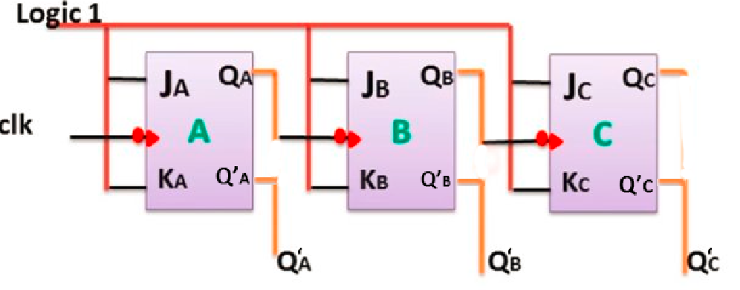
3-bit Asynchronous Down Counter

Slide 7
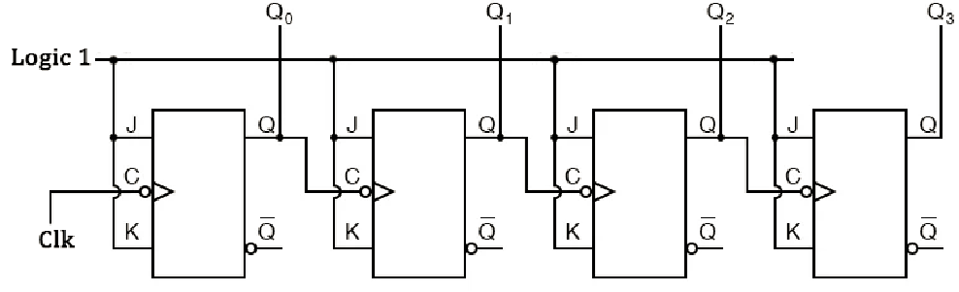
4-bit Asynchronous Up Counter

Slide 8
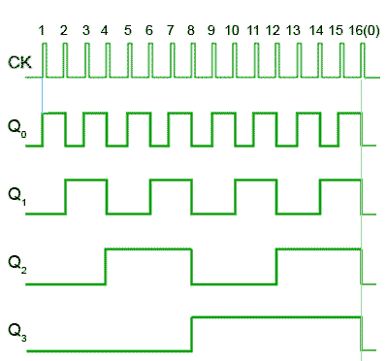
4-bit Asynchronous Up Counter

Slide 9
4-bit Asynchronous Up Counter
Clk | Q3 | Q2 | Q1 | Q0 | Dec
Initially(0) | 0 | 0 | 0 | 0 | 0
1st | 0 | 0 | 0 | 1 | 1
2nd | 0 | 0 | 1 | 0 | 2
3rd | 0 | 0 | 1 | 1 | 3
4th | 0 | 1 | 0 | 0 | 4
5th | 0 | 1 | 0 | 1 | 5
6th | 0 | 1 | 1 | 0 | 6
7th | 0 | 1 | 1 | 1 | 7
8th | 0 | 0 | 0 | 0 | 8
9th | 1 | 0 | 0 | 1 | 9
10th | 1 | 0 | 1 | 0 | 10
11th | 1 | 0 | 1 | 1 | 11
12th | 1 | 1 | 0 | 0 | 12
13th | 1 | 1 | 0 | 1 | 13
14th | 1 | 1 | 1 | 0 | 14
15th | 1 | 1 | 1 | 1 | 15

Slide 10
1. Design a 4-bit Asynchronous Down Counter.
2. Design a 2-bit Asynchronous Up Counter.
3. Design a 2-bit Asynchronous Down Counter.

Slide 11
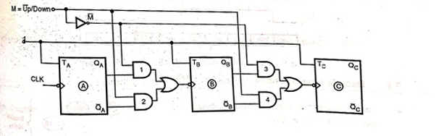
3 - bit Up/Down Ripple Counter
Clk = MQ' + M'Q

Slide 12
3 - bit Up/Down Ripple Counter
M | Q | Q' | Clk
0 (up) | 0 | 0 | 0
0 | 0 | 1 | 0
0 | 1 | 0 | 1
0 | 1 | 1 | 1
1 (down) | 0 | 0 | 0
1 | 0 | 1 | 1
1 | 1 | 0 | 0
1 | 1 | 1 | 1
QQ'
M
 |  | 1 | 1
 | 1 | 1
Clk = MQ' + M'Q

Slide 13
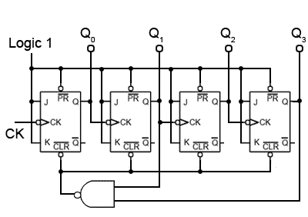
BCD Ripple Counter (Decade Counter)
0
1
1

Slide 14


BCD Ripple Counter (Decade Counter) Mod -10 Counter
BCD |  |  |  | Dec
Q3 | Q2 | Q1 | Q0
0 | 0 | 0 | 0 | 0
0 | 0 | 0 | 1 | 1
0 | 0 | 1 | 0 | 2
0 | 0 | 1 | 1 | 3
0 | 1 | 0 | 0 | 4
0 | 1 | 0 | 1 | 5
0 | 1 | 1 | 0 | 6
0 | 1 | 1 | 1 | 7
1 | 0 | 0 | 0 | 8
1 | 0 | 0 | 1 | 9
1 | 0 | 1 | 0 | 10

Slide 15
Mod-n(Modulus-n) Counters
Mod-5 Counter – has 5 states.
000(0)→ 001(1)→ 010(2) → 011(3) → 100(4)
Mod - 15 Counter - 15 states…. Max count - 14
Mod – 9 Counter – 9 states…. Max count - 8

Slide 16
Synchronous Counters
How to design Synchronous Counters?
Decide the number of flip flops.
Excitation table of flip flop.
State diagram and circuit excitation table.
Obtain simplified equations using K map.
Draw the logic diagram.

Slide 17
2-bit Synchronous Up Counter
00 → 01 → 10 → 11
Qn | Qn+1 | J | K
0 | 0 | 0 | X
0 | 1 | 1 | X
1 | 0 | x | 1
1 | 1 | x | 0
For Ja
Ja = Qb
Ka = Qb
Jb = 1
Kb = 1
Present state |  | Next state |  | f/f inputs
Qa | Qb | Qa+ | Qb+ | Ja | Ka | Jb | Kb
o | o | 0 | 1 | o | x | 1 | x
o | 1 | 1 | 0 | 1 | x | x | 1
1 | 0 | 1 | 1 | x | 0 | 1 | x
1 | 1 | 0 | 0 | x | 1 | x | 1
Qa Qb
0 1
0
1
 | 1
x | x

Slide 18
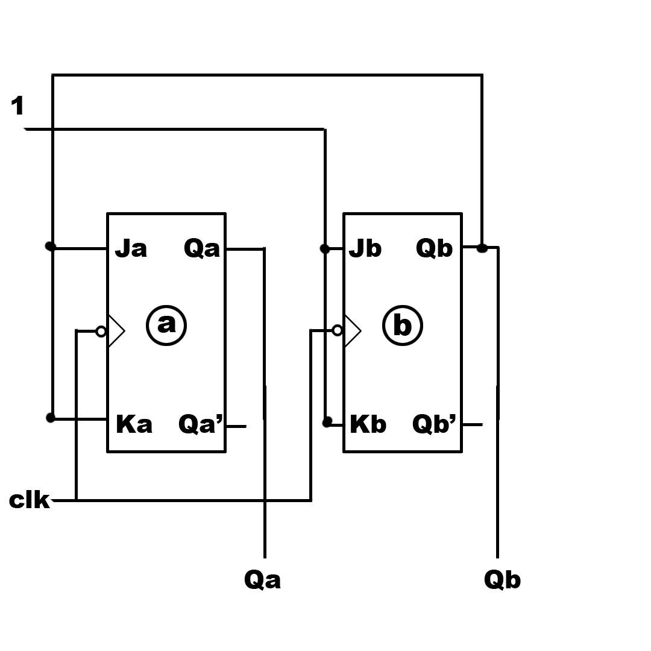
2-bit Synchronous Up Counter
Ja = Qb
Ka = Qb
Jb = 1
Kb = 1

Slide 19
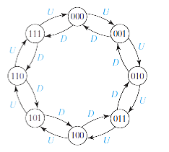
3-bit Synchronous Up/Down Counter
Q_{n} | Q_{n+1} | T
0 | 0 | 0
0 | 1 | 1
1 | 0 | 1
1 | 1 | 0

Slide 20
M | Q_{C} | Q_{B} | Q_{A} | Q_{C}⁺ | Q_{B}⁺ | Q_{A}⁺ | T_{C} | T_{B} | T_{A}
0 | 0 | 0 | 0 | 0 | 0 | 1 | 0 | 0 | 1
0 | 0 | 0 | 1 | 0 | 1 | 0 | 0 | 1 | 1
0 | 0 | 1 | 0 | 0 | 1 | 1 | 0 | 0 | 1
0 | 0 | 1 | 1 | 1 | 0 | 0 | 1 | 1 | 1
0 | 1 | 0 | 0 | 1 | 0 | 1 | 0 | 0 | 1
0 | 1 | 0 | 1 | 1 | 1 | 0 | 0 | 1 | 1
0 | 1 | 1 | 0 | 1 | 1 | 1 | 0 | 0 | 1
0 | 1 | 1 | 1 | 0 | 0 | 0 | 1 | 1 | 1
1 | 0 | 0 | 0 | 1 | 1 | 1 | 1 | 1 | 1
1 | 0 | 0 | 1 | 0 | 0 | 0 | 0 | 0 | 1
1 | 0 | 1 | 0 | 0 | 0 | 1 | 0 | 1 | 1
1 | 0 | 1 | 1 | 0 | 1 | 0 | 0 | 0 | 1
1 | 1 | 0 | 0 | 0 | 1 | 1 | 1 | 1 | 1
1 | 1 | 0 | 1 | 1 | 0 | 0 | 0 | 0 | 1
1 | 1 | 1 | 0 | 1 | 0 | 1 | 0 | 1 | 1
1 | 1 | 1 | 1 | 1 | 1 | 0 | 0 | 0 | 1

Slide 21
3-bit Synchronous Up/Down Counter
T_{A} = 1
T_{B} = M'Q_{A} + MQ_{A}'
T_{C} = M'Q_{B}Q_{A} + MQ_{B}'Q_{A}'
Q_{B} Q_{A}
M Q_{C}
For T_{C}
For T_{B}
00 01 11 10
00
01
11
10
 |  | 1
 |  | 1
1
1
Q_{B} Q_{A}
M Q_{C}
00 01 11 10
00
01
11
10
 | 1 | 1
 | 1 | 1
1 |  |  | 1
1 |  |  | 1

Slide 22
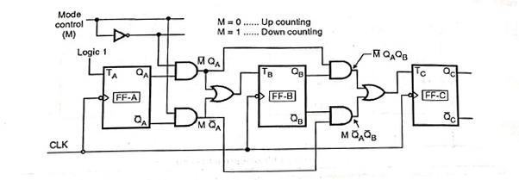
3-bit Synchronous Up/Down Counter
T_{A} = 1
T_{B} = M'Q_{A} + MQ_{A}'
T_{C} = M'Q_{B}Q_{A} + MQ_{B}'Q_{A}'

Slide 23
1. Design a 3-bit Synchronous Down Counter.
2. Design a 3-bit Synchronous Up Counter.

Slide 24
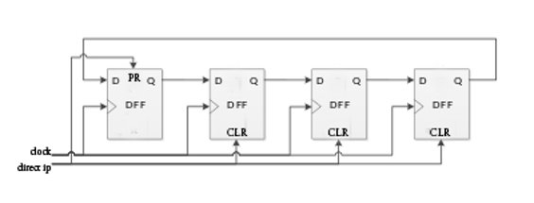
Ring Counter
Special type of Counter.
Output of last flip-flop is connected to first flip-flop.
No. of states = No. of flip-flops used.
PR= 0; Q = 1 and CLR = 0; Q = 0
Pre

Slide 25
Ring Counter
0
0
1
0
0
0
0
1
1
0
0
0
o
1
1
o
0
o
0
o
Direct i/p | Q1 | Q2 | Q3 | Q4
low | 1 | 0 | 0 | 0
high | 0 | 1 | 0 | 0
high | 0 | 0 | 1 | 0
high | 0 | 0 | 0 | 1
high | 1 | 0 | 0 | 0

Slide 26
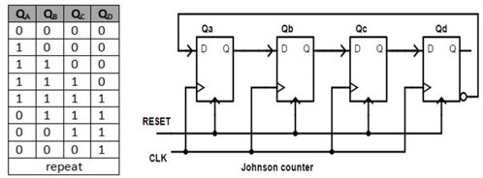
Johnson Counter
Modified from Ring Counter.
Twisted Ring Counter.
No. of states = 2 x [No. of flip-flops used]

